Slide 1
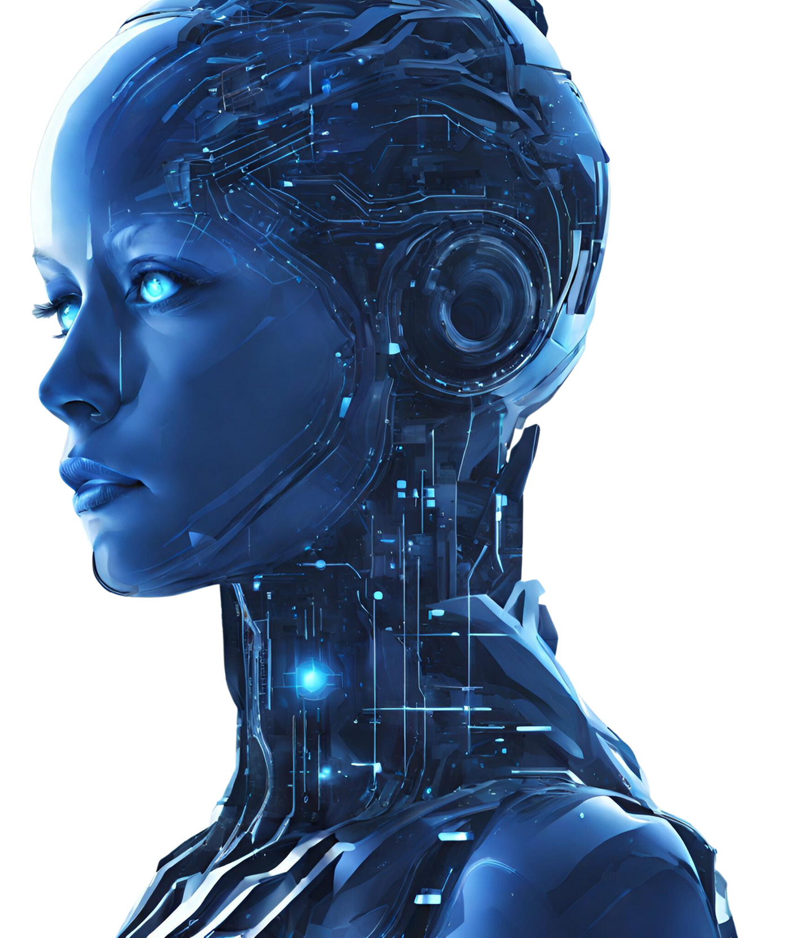




Huawei HCCDA-AI Certification
Initiated by
National Vocational And Technical Training Commission

Slide 2


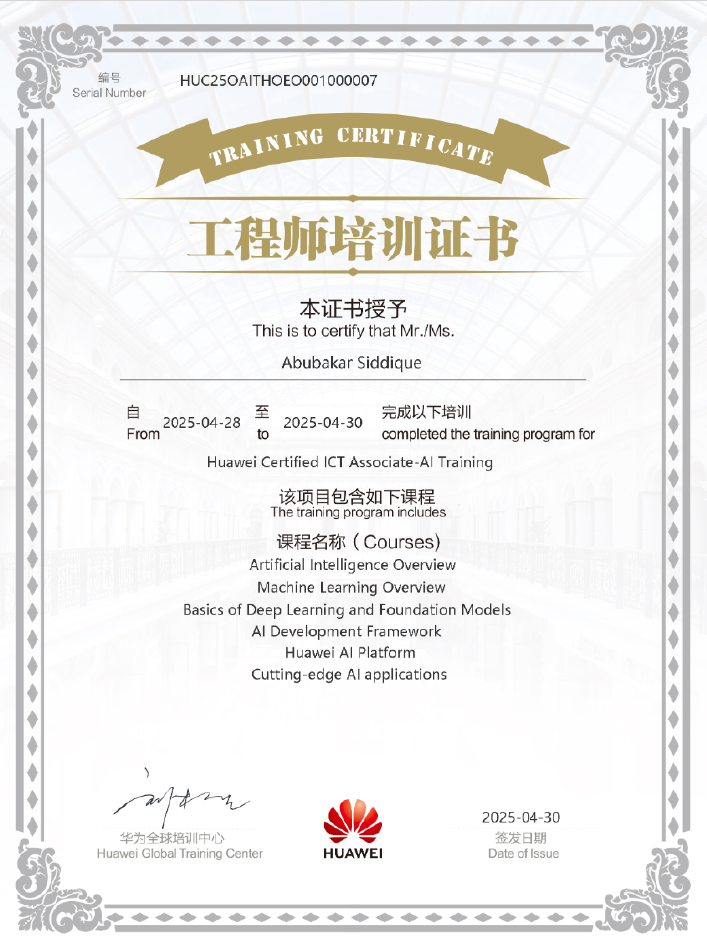
Welcome To
HCIA-AI Certification
I’m Abubakar.
Huawei Certified ICT Associate-AI Trainer
Full-stack AI Engineer, MS in WSN

Slide 3

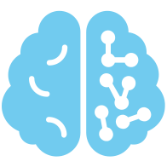
Takeaway
Huawei Cloud AI
AI/ML/DL Core
AI Agents
Services for AI Agents
Fundamentals of AI
AI based Applications

Slide 4


To AI and Huawei Strategy
1
Introduction to AI & Huawei Strategy

Slide 5
What is AI?
AI
Brain Science
Cognitive Science
Psychology
Linguistics
Logic
Philosophy
Computer Science
Artificial Intelligence (AI) is a new technical science that studies and develops theories, methods, techniques, and application systems for simulating and extending human intelligence. In 1956, the concept of AI was first proposed by John McCarthy, who defined the subject as “Science and engineering of making intelligent machines, especially intelligent computer program. AI is concerned with making machines work in an interdisciplinary course that involves various fields.

Slide 6
“I propose to consider the question, ‘Can machines think”
— Alan Turing in 1950

Slide 7
“Make machines behave like humans”
— Jon McCarthy in 1956

Slide 8
““Artificial intelligence is the science of making machine do things that would require intelligence if done by men”
— Marvin Minsky

Slide 9
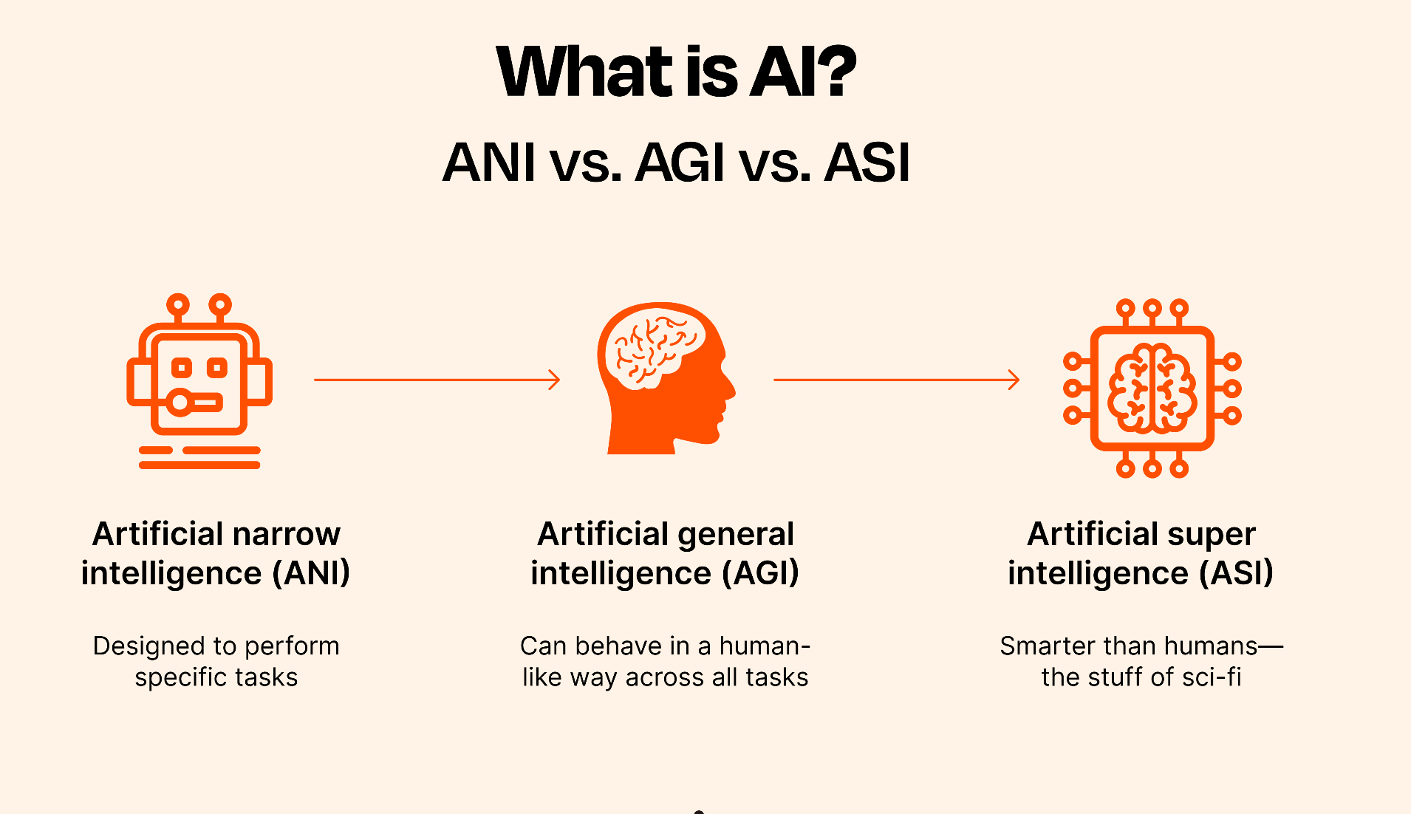

Slide 10
Key differences
Weak AI (Narrow AI)
Strong AI (AGI)
General AI
Hypothetical AI with human-like intelligence, capable of learning, reasoning, and performing any intellectual task a human can. It would adapt across domains without task-specific programming.
Not yet achieved.
Often used interchangeably with Strong AI, but some distinguish it as a broader concept, implying not just human-level intelligence but potentially superhuman capabilities across all domains, with flexibility to tackle any problem
Designed for specific tasks, like image recognition or language translation. It operates within predefined limits, lacks general intelligence, and can't adapt to unrelated tasks.
Examples: Siri, recommendation algorithms.

Slide 11
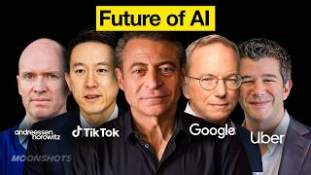
How should companies and countries think about AI to drive growth and prosperity?
AI or Die
AI or Die
The Mantra of AI or die is real and certainly companies and countries that do not engage will die.
Notes:
https://www.youtube.com/watch?v=uqc8PWYq9Hw

Slide 12
Top 3 Reasons for Choosing AI as a Career in 2025
Reason | Description | Supporting Details
High Demand for AI Talent | AI skills are in short supply, with global demand driving job opportunities across industries. | - Global AI market projected at $371.71B in 2025, growing to $2.4T by 2032 (CAGR 30.6%). - Job postings for AI roles (e.g., ML engineers, data scientists) up 20% YoY in 2024. - Companies like NVIDIA, Microsoft, and OpenAI actively recruit AI specialists.
Well-paid Salaries | AI professionals earn high salaries due to specialized skills and market needs. | - Average U.S. AI engineer salary: $160,000-$250,000 annually (2025). - Senior roles (e.g., AI research scientists) can exceed $500,000 with bonuses. - Startups like Anthropic and xAI offer competitive equity packages.
Impactful Innovation | AI careers enable professionals to drive cutting-edge solutions for real-world challenges. | - Contribute to advancements like autonomous vehicles (NVIDIA), drug discovery (BenevolentAI), or conversational AI (xAI’s Grok). - Aligns with mission-driven goals (e.g., xAI’s focus on human discovery). - Shapes future technologies like generative AI and neuro-symbolic systems.

Slide 13
Top Five AI Careers in 2025
Career | Description | Key Details
Machine Learning Engineer | Designs, builds, and deploys machine learning models for tasks like image recognition and NLP. | - Salary: $150,000-$250,000 (U.S. average, 2025). - Demand: High, with 20% YoY job posting growth. - Skills: Python, TensorFlow, PyTorch; expertise in neural networks (Connectionism). - Employers: NVIDIA, Google, Amazon.
Data Scientist | Analyzes large datasets to derive insights, using statistical and AI techniques for predictive modeling. | - Salary: $120,000-$200,000 annually. - Demand: Critical in finance, healthcare (e.g., IBM Watsonx). - Skills: Bayesian methods, data visualization, SQL. - Employers: Microsoft, Palantir, BenevolentAI.
AI Research Scientist | Conducts cutting-edge research to advance AI algorithms, focusing on LLMs or neuro-symbolic AI. | - Salary: $200,000-$500,000+ (senior roles). - Demand: Growing in R&D hubs like DeepMind, xAI. - Skills: PhD often required; expertise in deep learning, reinforcement learning. - Employers: OpenAI, Anthropic, xAI.
AI Ethics Specialist | Ensures AI systems are fair, transparent, and compliant with regulations like GDPR and CCPA. | - Salary: $100,000-$180,000 annually. - Demand: Rising due to ethical concerns (e.g., bias in LLMs). - Skills: Policy analysis, knowledge of AI frameworks. - Employers: Anthropic, Meta, government agencies.
Robotics Engineer | Develops AI-driven robots for automation, navigation, and industrial applications. | - Salary: $130,000-$220,000 annually. - Demand: Strong in automotive, manufacturing (e.g., NVIDIA’s platforms). - Skills: ROS, behavior-based AI, computer vision. - Employers: NVIDIA, Amazon, Tesla.

Slide 14
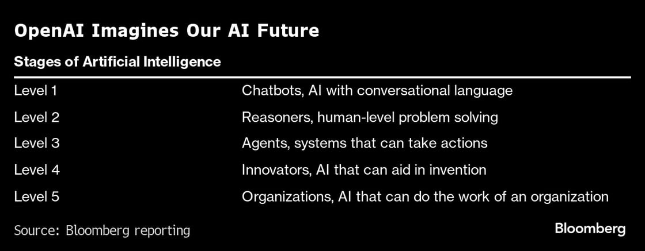
Road To AGI

Slide 15
Three Waves of AI
Predictive AI
Generative AI
Agentic AI
Focus on creating content from data.
Creating content (text, images, code, videos).
Why It Mattered: Empowered creativity and productivity.
Focus on autonomous actions and learning iteratively.
Autonomous actions, environment interaction, iterative learning.
Why It Matters: AI becomes proactive, managing complex tasks.
Focus on analyzing data to predict outcomes.
Analyze past data to predict future outcomes.
Why It Mattered: Enabled data-driven decision-making.

Slide 16
Strong AI vs Weak AI
Strong AI
The strong AI views hold that it is possible to create intelligence machines that can really reason and solve problems. Such machines are considered to be conscious and self-aware, can independently think about problems and work out optimal solutions to problems, have their own system of values and world views, and have all the same instincts as living things, such as survival and security needs. It can be regarded as new civilization in a certain sense.
Weak AI
The weak AI views hold that intelligence machines can not really reason and solve problems. These machines only look intelligent, but do not have real intelligence or self-awareness.

Slide 17
Concepts about Artificial Intelligence and Machine Learning
AI
Statistics
Pattern Recognition
Neuro Computing
Machine Learning
Data Mining
Databases
KDD

Slide 18


Scope of AI

Slide 19
Scope of AI
Machine Learning Algorithms that learn from data to make predictions or decisions | NLP Enabling machines to understand and generate human language. | Computer Vision Interpreting and processing visual information like images and videos .
Robotics Designing intelligent machines for physical tasks | Expert Systems AI that mimics human expertise in specific domains | Automation Streamlining repetitive tasks across industries.

Slide 20

Difference between AI, Machine Learning and Deep Learning
AI (Artificial Intelligence) is the broad field of creating systems that mimic human intelligence, such as reasoning, problem-solving, and decision-making.
Machine Learning (ML) is a subset of AI, where algorithms learn patterns from data to make predictions or decisions without explicit programming.
Deep Learning (DL) is a specialized subset of ML, using neural networks with multiple layers to process complex data, like images or speech, achieving high accuracy in tasks like recognition and generation.
Relationship: AI encompasses ML, which includes DL as a more advanced technique leveraging neural networks for complex tasks.

Slide 21



About AI
Major Schools of Thought in Artificial Intelligence

Slide 22
Major Schools of Thought in Artificial Intelligence
School of Thoughts | Core Principals | Strengths | Limitations | Example Applications
Symbolic AI (GOFAI) | Uses symbols and explicit rules for knowledge representation and logical reasoning. | Transparent, interpretable; effective for structured, rule-based tasks. | Struggles with scalability, ambiguity, and perception tasks; labor-intensive | Expert systems (e.g., MYCIN), chess engines
Connectionism | Neural networks learn patterns from data via interconnected nodes and optimization | Excels in pattern recognition, scales with data, handles unstructured inputs | Black-box nature, data/compute-intensive, vulnerable to adversarial examples | | Image recognition, NLP (e.g., GPT, BERT).
Bayesian AI | Probabilistic reasoning using Bayes’ theorem to manage uncertainty and inference | Robust for noisy data, interpretable probabilities, handles uncertainty | Computationally intensive, needs accurate priors, less suited for deep learning. | Robotics, medical diagnosis, spam filtering
Evolutionary AI | Mimics biological evolution with population-based optimization and fitness functions | Finds novel solutions, robust for complex optimization, no need for gradients. | Slow, computationally expensive, requires parameter tuning | Neural architecture search, optimization
Behavior-Based AI | Reactive systems with modular behaviors interacting in real-world environments | Adaptive, efficient for real-time tasks, robust in dynamic settings | Limited for planning or abstract reasoning, potential behavior conflicts | Robotic navigation, obstacle avoidance
Hybrid Approaches | Combines multiple paradigms (e.g., symbolic + neural) for versatile intelligence | Leverages strengths of multiple approaches, aims for general intelligence | Complex to design, inherits some limitations, resource-intensive | Neuro-symbolic AI, autonomous driving

Slide 23
Top 10 Companies in the Global AI Industry Landscape 2025
Company | Key AI Offerings | Primary Sectors | Notable Details
NVIDIA | AI chips (Blackwell platform, H100 GPUs), DGX systems, autonomous driving platforms | Semiconductor, Automotive, Data Centers, Defense | Market cap ~$3 trillion; dominates AI hardware with CUDA; demand outstrips supply
Microsoft | Azure OpenAI, Copilot, AI-integrated cloud services | Healthcare, Finance, Retail, IT/Telecom, Manufacturing | Invested $14B in OpenAI; plans $80B for AI data centers in 2025
Google (Alphabet) | Gemini models, Vertex AI, DeepMind, AI for search and cloud | Healthcare, Finance, Retail, Transportation, Marketing | Investing $75B in AI infrastructure; Gemini enhances smart devices
Amazon | AWS Bedrock, Rufus (shopping assistant), Rekognition, Lambda | Retail, Cybersecurity, Healthcare, Finance | Rufus launched 2024; AWS powers scalable AI deployment
OpenAI | ChatGPT, DALL-E, Sora for text, image, and video generation | Media & Entertainment, Education, Customer Service | Valuation ~$340B; faces copyright litigation; partnered with Microsoft
Anthropic | Claude (safety-focused LLMs), AI for enterprise applications | Finance, Legal, Customer Service | Valuation $61.5B; founded by ex-OpenAI researchers; 100M monthly Claude visits
xAI | Grok (conversational AI with web search, image understanding) | Education, Research, Customer Service | Valuation ~$75B; focuses on human discovery; Grok 3 widely accessible
Palantir | Foundry, Gotham, AIP for AI-driven analytics | Defense, Manufacturing, Intelligence | Market cap ~$220B; strong in government contracts; AIP for secure LLMs
Meta | Meta AI, Llama models, AI for content recommendations, Metaverse | Social Media, Virtual Reality, Marketing | Enhances user experiences on Facebook, Instagram; invests in AI for Metaverse
IBM | Watsonx (AI suite with governance), hybrid cloud AI solutions | Healthcare, Insurance, Telecom | Focuses on trustworthy AI for regulated industries; strong enterprise adoption

